Slide 1
UI Wireframe Docking System

Slide 2
VDE Window
Shows the physical test rig live in 3D while the test runs: the base, the six Stewart legs, the moving platform carrying the Chaser docking mechanism, and the overhead platform carrying the Target.
Each frame (B_sp, P_sp, O_sp) is drawn as red, green and blue axes, and the view can be rotated, panned and zoomed with the mouse.
Below the view, 6 graphs plot any chosen value against time, and each graph can be popped out to full size.
The toolbar has Record Video, Export Data, Open Analysis and Replay.

Slide 3
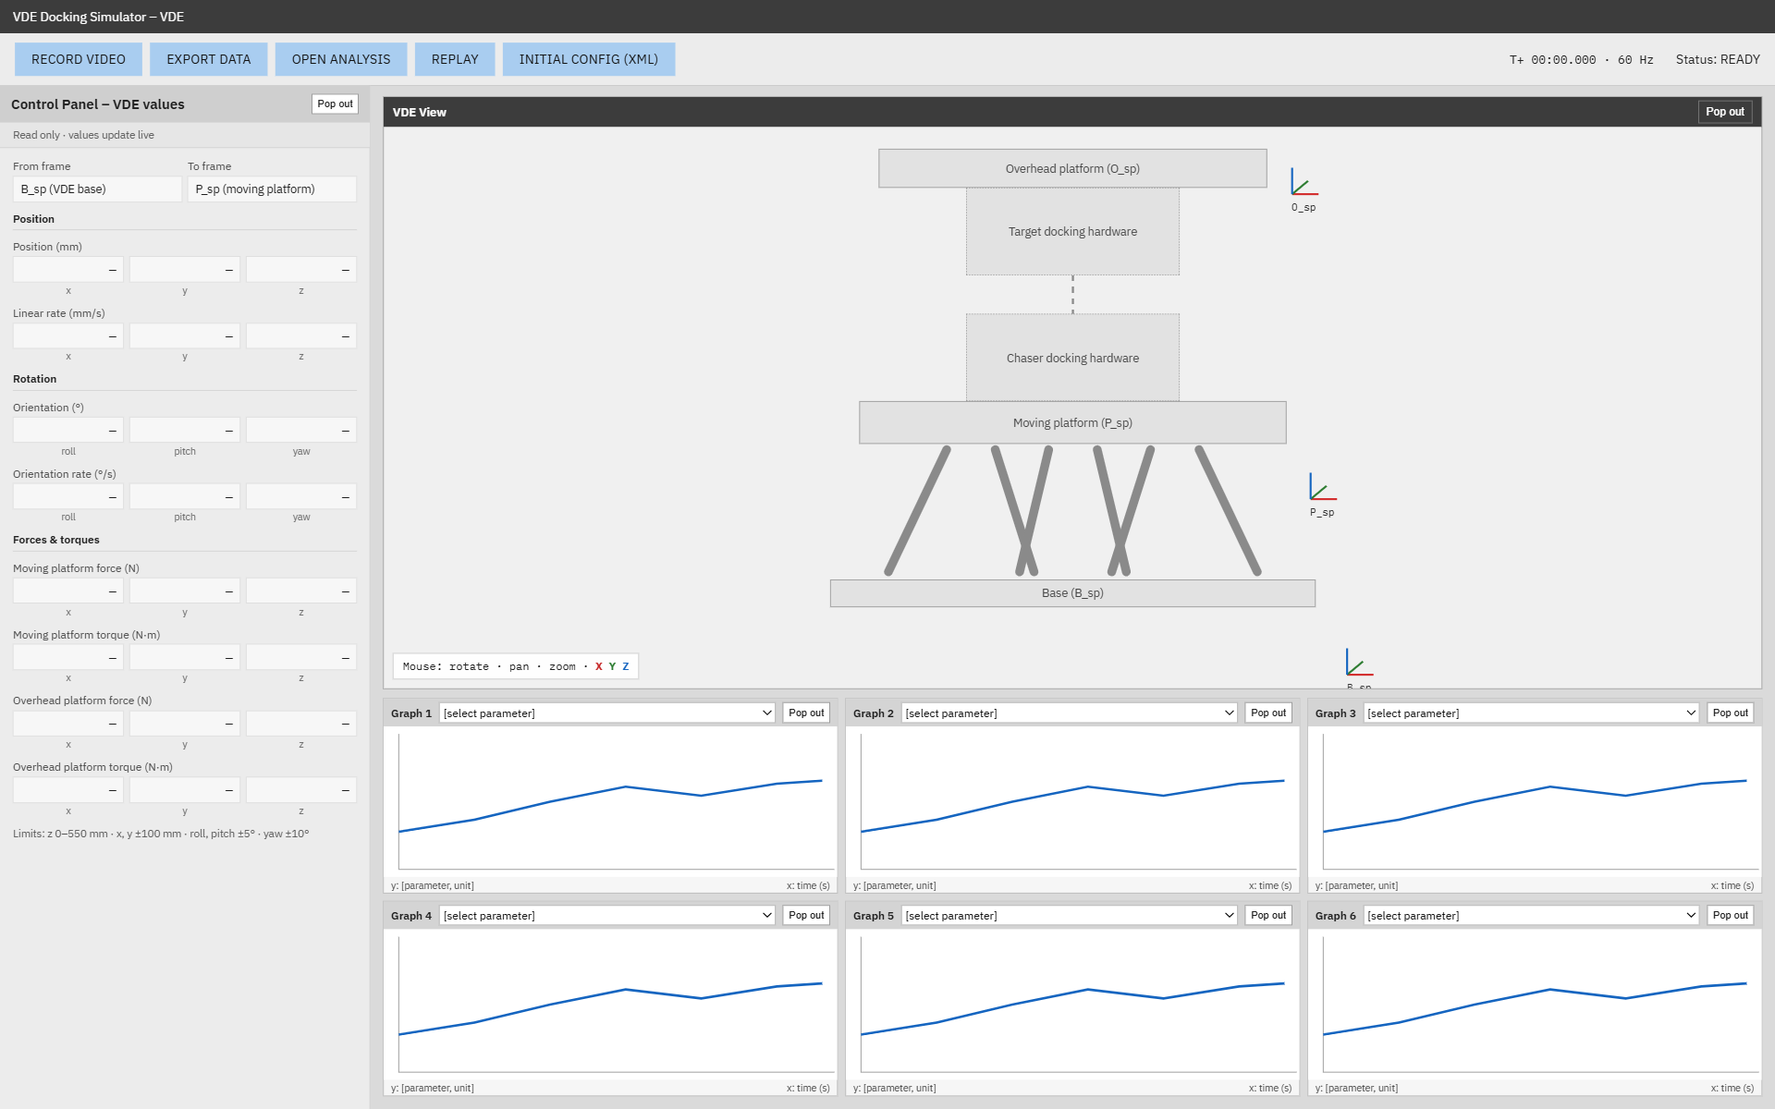

Slide 4
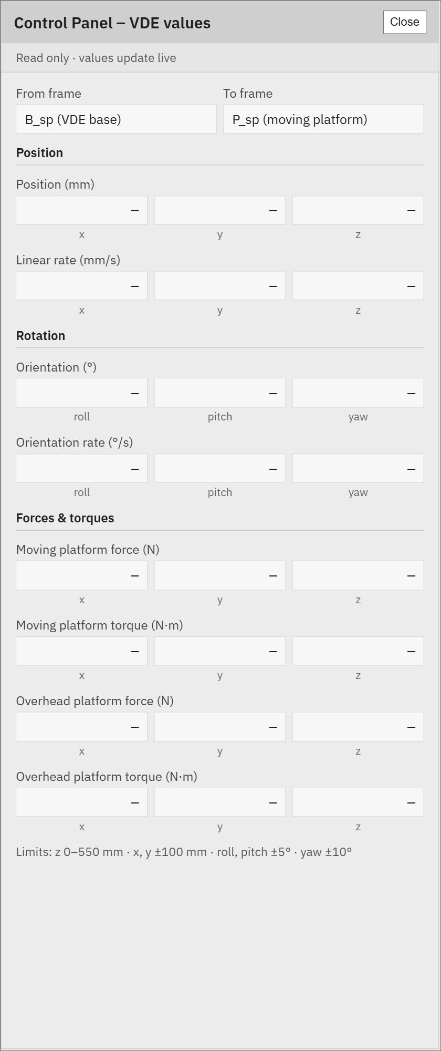
VDE Control Panel
A read-only panel beside the view that shows the live VDE values; the operator can see them but not change them.
It shows the moving platform’s position (mm), linear rate (mm/s), orientation as roll, pitch and yaw (°), and orientation rate (°/s), all measured from the base.
It also shows the forces (N) and torques (N·m) on the moving and overhead platforms during contact.
The platform’s movement limits and the rig’s 3D model are listed at the bottom, and the panel can be popped out into its own window.

Slide 5
Analysis Window
Opens when the operator clicks Open Analysis in the VDE window.
Shows 12 graphs at once in a 4 × 3 grid, giving a larger view for studying a test in detail.
Each graph plots any chosen value against time, picked from the dropdown at its top, and can be popped out to full size.
Close returns to the VDE window.
Initial Configuration (XML)
Opens when the operator clicks Initial Config (XML) in the VDE window.
Shows the starting setup of the test, read from the config.xml file: Chaser and Target properties, orbit, NGC mode and the VDE starting state.
It’s read-only, so the operator can check the configuration but not change it.
Close returns to the VDE window.

Slide 6
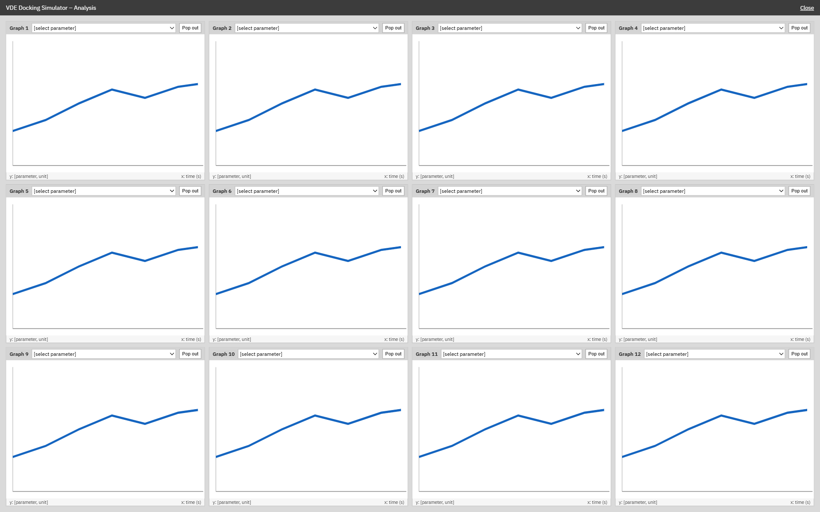

Slide 7
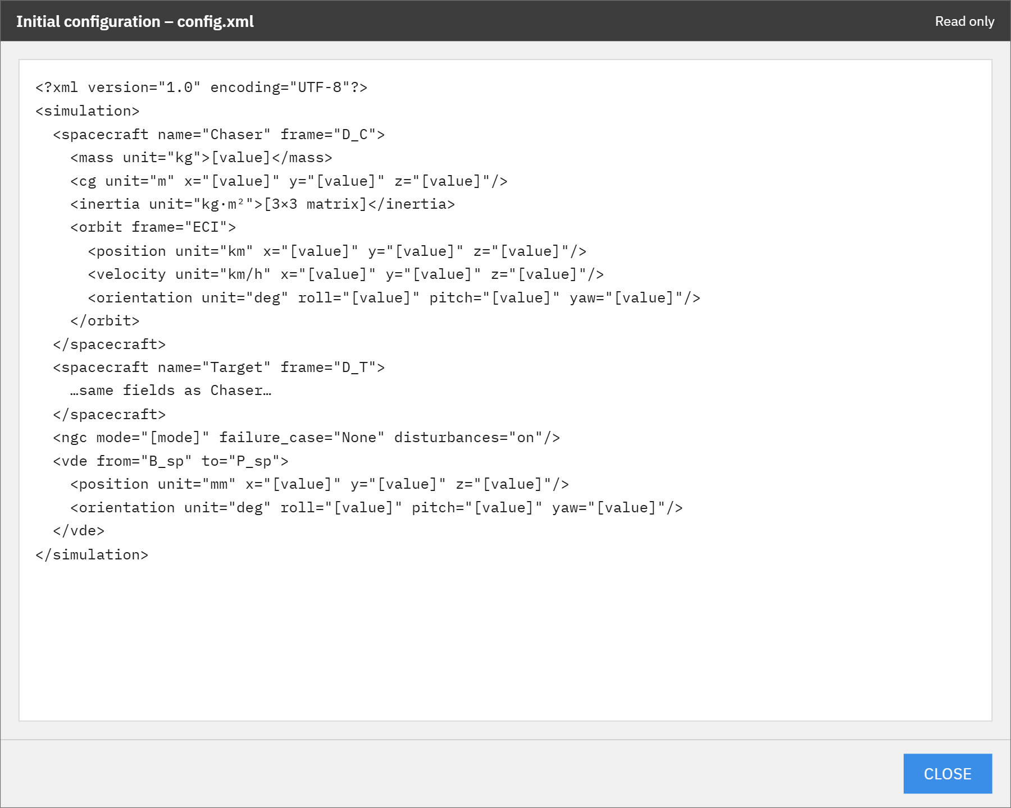

Slide 8
Spacecraft Window
Shows the simulated Chaser and Target spacecraft live in 3D, in orbit above Earth, with their docking mechanisms facing each other.
Each spacecraft frame (B_C, D_C, D_T, B_T) is drawn as red, green and blue axes, and the view can be rotated, panned and zoomed with the mouse.
Below the view, 6 graphs plot any chosen value against time, and each graph can be popped out to full size.
The toolbar has Record Video and Export Data.

Slide 9
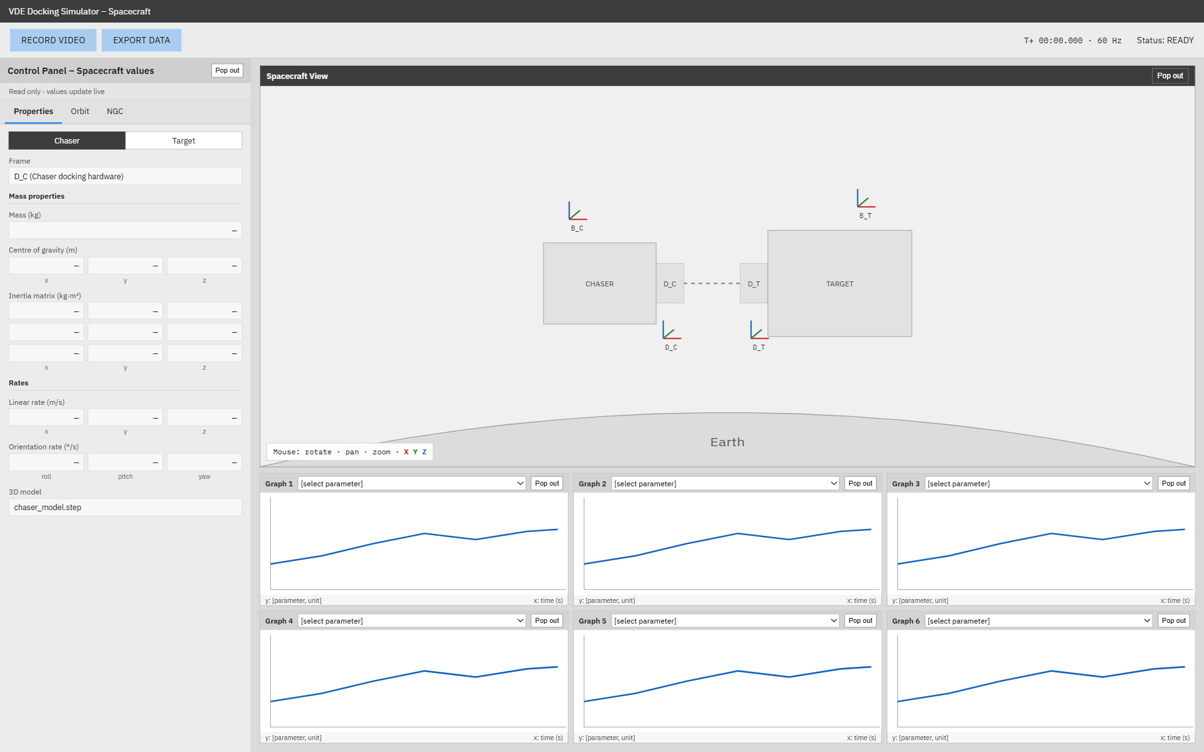

Slide 10
Spacecraft Control Panel
Properties
A read-only panel beside the view that shows the live spacecraft values; the operator can see them but not change them.
A Chaser / Target switch at the top chooses which spacecraft’s values are shown, along with the frame they’re measured in.
The Properties tab shows the mass (kg), centre of gravity (m) and 3×3 inertia matrix (kg·m²), which describes how hard the spacecraft is to rotate.
It also shows the linear rate (m/s) and orientation rate (°/s), and the panel can be popped out into its own window.
Orbit
Shows where the selected spacecraft is in orbit, measured from Earth’s centre (ECI frame).
Position (km) and velocity (km/h) give where it is and how fast it’s moving in x, y and z.
Orientation (°) and orientation rate (°/s) give how it’s pointed (roll, pitch, yaw) and how fast it’s turning.
NGC
Shows the inputs from the Navigation, Guidance and Control system.
It lists the active NGC mode and the failure case being simulated.
The force (N) and torque (N·m) applied to the Chaser and to the Target are shown, each in its own body frame.
It also shows whether small natural disturbances, such as drag, are switched on.

Slide 11
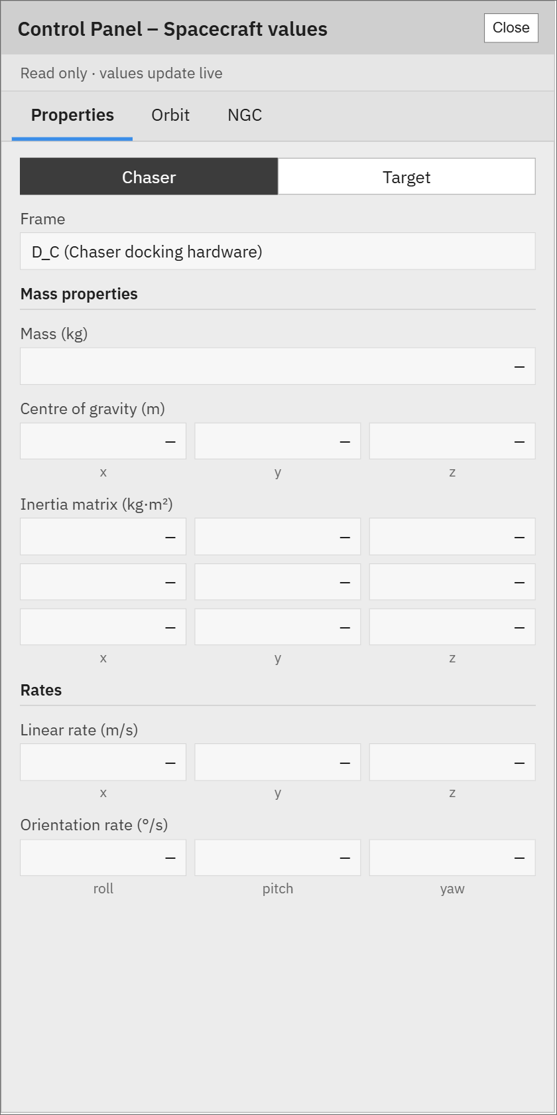
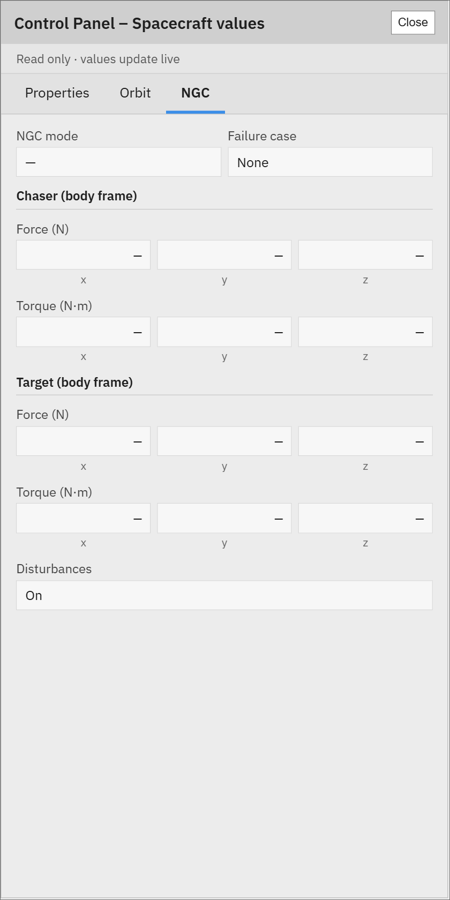
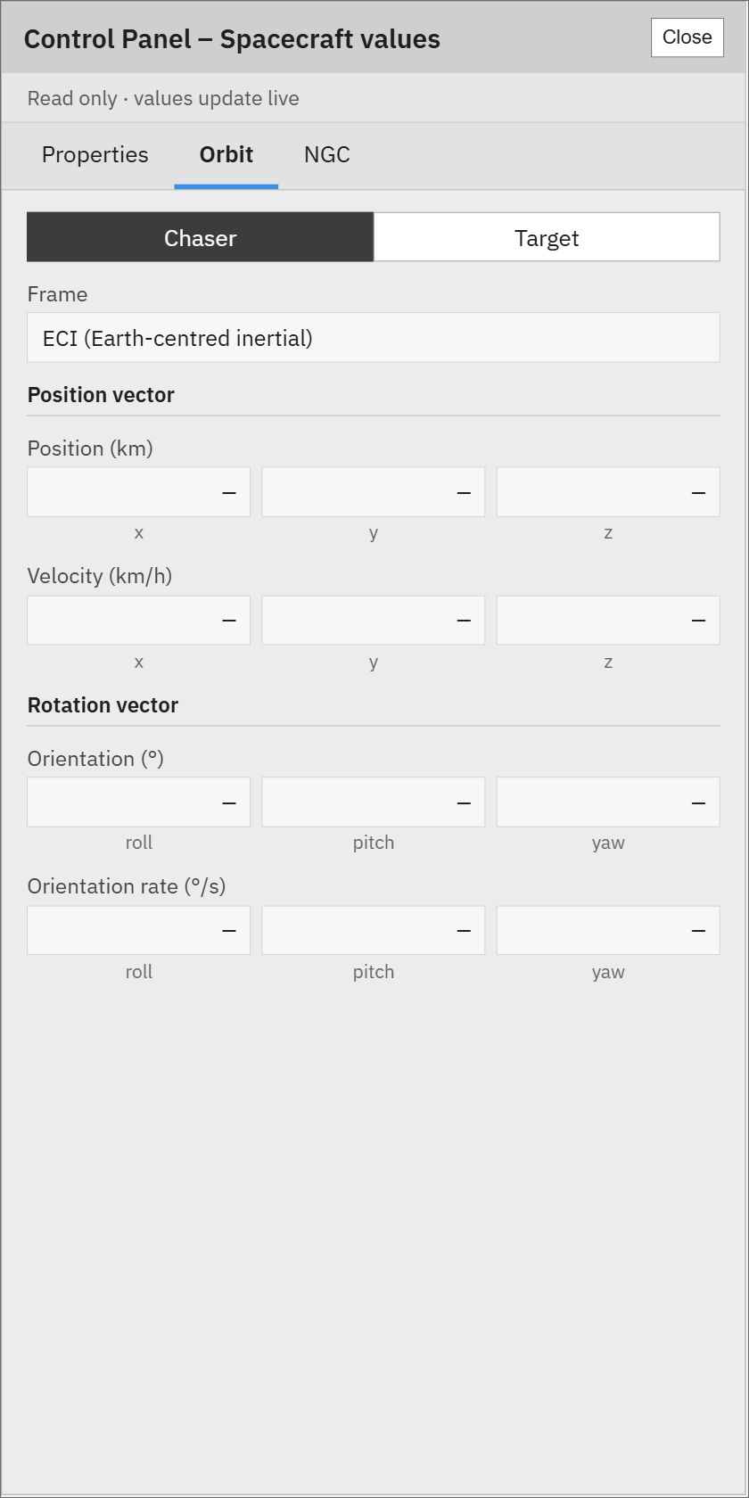

Slide 12
Replay Dialog
Opens when the operator clicks Replay.
Step 1 chooses where to replay: the VDE View, the Spacecraft View, or both.
Step 2 picks the saved CSV file of a past run, the same file Export Data creates.

Slide 13
